Slide 1




Spring Data Introduction
Spring Data, Repositories, Services
Databases
Frameworks
SoftUni Team
Technical Trainers
Software University
http://softuni.bg

Slide 2
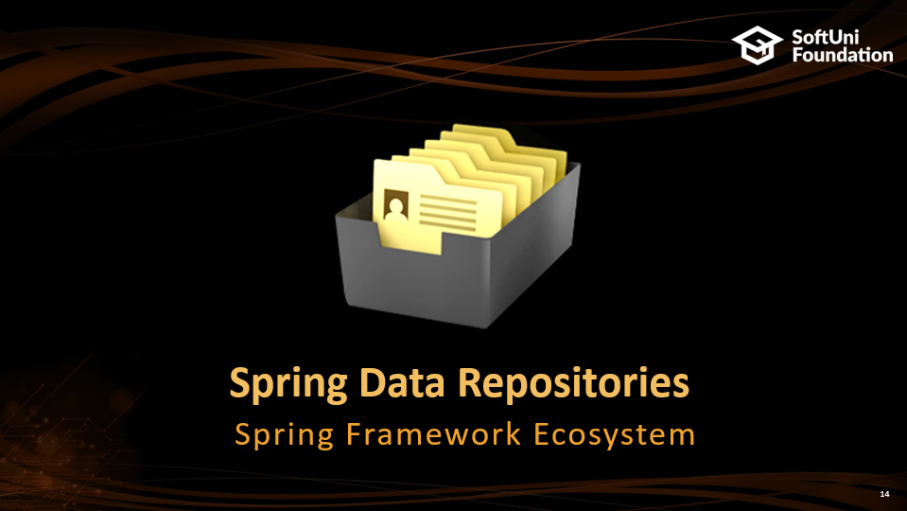

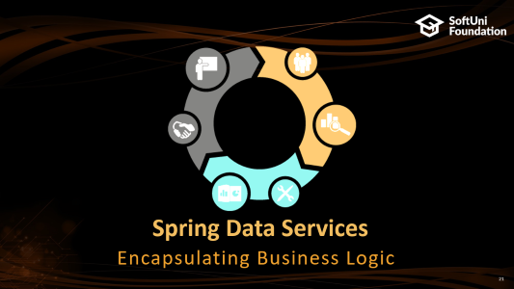
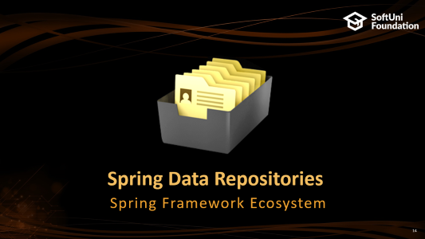
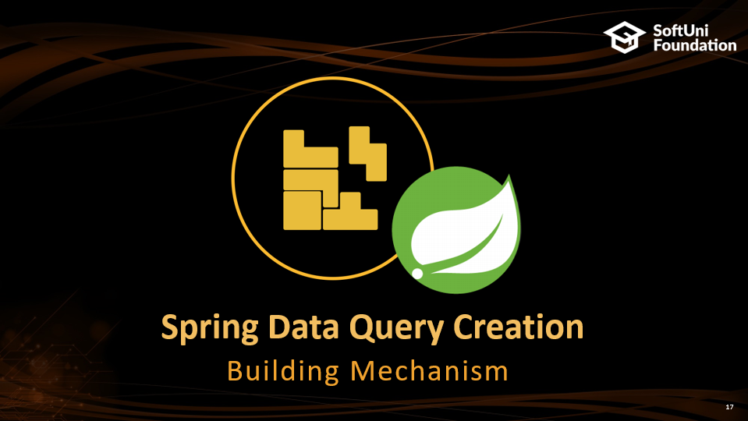


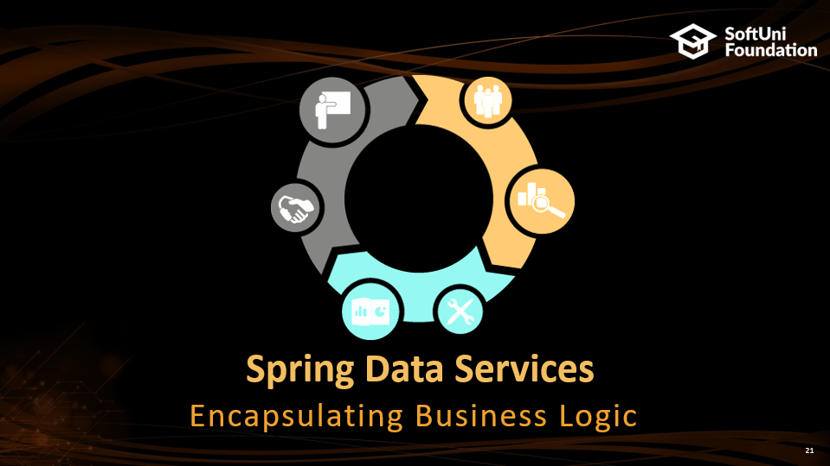
Table of Contents

Slide 3
Questions
sli.do #db-advanced

Slide 4

Spring Data Framework
Spring Framework Ecosystem

Slide 5
What is Spring Framework
Application framework for the Java Platform
Technology stack - includes several modules that provide a range of services
Data Access
JDBC
ORM
Transactions
Web
Sockets
Servlets
Spring Data
Component
Core Container
Core, Context, Beans
Test
Spring Framework Overview

Slide 6

What is Spring Data
Library that adds an extra layer of abstraction on the top of our JPA provider
Provides:
Dynamic query derivation from repository method names
Possibility to integrate custom repositories and many more
What Spring Data is not:
Spring Data JPA is not a JPA provider

Slide 7
Spring Data Role
Spring Data
Extra layer of abstraction
over the used ORM
Hibernate, EclipseLink etc.
JPA
RDBMS
NRDBMS

Slide 8
Spring Boot – Convention over configuration
Creates stand-alone Spring applications
Provide opinionated 'starter' POMs to simplify your Maven configuration
Automatically configure Spring whenever possible
Absolutely no code generation and no requirement for XML configuration

Slide 9
Dependencies
pom.xml
<parent>
<groupId>org.springframework.boot</groupId>
<artifactId>spring-boot-starter-parent</artifactId>
<version>1.4.1.RELEASE</version>
</parent>

Slide 10
Dependencies (2)
pom.xml
<dependencies>
<dependency>
<groupId>org.springframework.boot</groupId>
<artifactId>spring-boot-starter-data-jpa</artifactId>
</dependency>
<dependency>
<groupId>mysql</groupId>
<artifactId>mysql-connector-java</artifactId>
</dependency>
</dependencies>
Spring Data
MySQL Connector

Slide 11
Build
pom.xml
<build>
<plugins>
<plugin>
<groupId>org.apache.maven.plugins</groupId>
<artifactId>maven-compiler-plugin</artifactId>
<version>3.5.1</version>
<configuration>
<source>1.8</source>
<target>1.8</target>
</configuration>
</plugin>
</plugins>
</build>
Java compile version

Slide 12
Configuration
Spring boot configurations are held in a application.properties file
application.properties
#Data Source Properties
spring.datasource.driverClassName = com.mysql.jdbc.Driver
spring.datasource.url = jdbc:mysql://localhost:3306/school?useSSL=false
spring.datasource.username = root
spring.datasource.password = 1234
#JPA Properties
spring.jpa.properties.hibernate.dialect = org.hibernate.dialect.MySQL5InnoDBDialect
spring.jpa.properties.hibernate.format_sql = TRUE
spring.jpa.hibernate.ddl-auto = create-drop
Database Connection
JPA properties

Slide 13
Configuration (2)
application.properties
…
###Logging Levels
# Disable the default loggers
logging.level.org = WARN
logging.level.blog = WARN
#Show SQL executed with parameter bindings
logging.level.org.hibernate.SQL = DEBUG
logging.level.org.hibernate.type.descriptor = TRACE
Loggin settings

Slide 14

Spring Data Repositories
Spring Framework Ecosystem

Slide 15
Spring Repository
Abstraction to significantly reduce the amount of boilerplate code required to implement data access layers
Perform CRUD Operations
Automatically generates JPQL/SQL code
Highly customizable

Slide 16

Built-in CRUD Operations
JPA REPOSITORY
- <S extends T> S save(S var1);
- <S extends T> Iterable<S> save(Iterable<S> var1);
- T findOne(ID var1);
- boolean exists(ID var1);
- Iterable<T> findAll();
- long count();
- void delete(ID var1);
void deleteAll();
…

Slide 17

Spring Data Query Creation
Building Mechanism

Slide 18

Query Creation
Queries are created via a query builder mechanism built into Spring Data
Strips the prefixes like find…By, read…By, query…By and starts parsing the rest of it
Spring Data JPA will do a property check
and traverse nested properties

Slide 19
Custom CRUD Operations
StudentRepository.java
@Repository
public interface StudentDao extends CrudRepository<Student, Long> {
List<Student> findByMajor(Major major);
}
Cutom method
SQL
SELECT s.*
FROM students AS s
INNER JOIN majors AS m
ON s.major_id = m.id
WHERE m.id = ?

Slide 20
Query Lookup Strategies
Keyword | Sample | JPQL
And | findByLastnameAndFirstName | … where x.last_name = ?1 and x.firstname = ?2
Or | findByLastnameOrFistname | … where x.lastname = ?1 or x.firstname = ?2
Between | findByStartDateBetween | … where x.startDate between 1? and ?2
LessThan | findByAgeLessThan | … where x.age < ?1
Containing | findByFirstnameContaining | … where x.firstname like ?1 (parameter bound wrapped in %)
In | findByAgeIn(Collection<Age> ages) | … where x.age in ?1

Slide 21
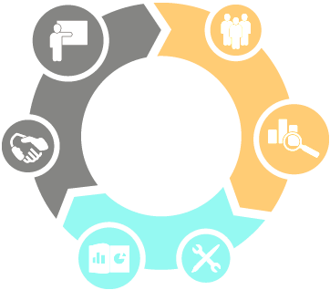
Spring Data Services
Encapsulating Business Logic

Slide 22
Service Pattern
Service Layer is a design pattern of organizing business logic into layers
Service classes are categorized into a particular layer and share functionality
Main concept is not exposing details of internal processes on entities
Services interact closely with Repositories

Slide 23
Spring Data Architecture
SERVICE IMPLEMENTATION
SERVICE
MODEL REPOSITORY
JPA REPOSITORY
MODEL

Slide 24
Services
StudentService.java
public interface StudentService {
void register(Student student);
void expel(Student student);
void expel(long id);
Student findStudent(long id);
List<Student> findSampleByMajor(Major major);
}
Business Logic

Slide 25
Services
StudentServiceImpl.java
Service Implementation
@Service
public class StudentServiceImpl implements StudentService {
@Autowired
private StudentRepository studentRepository;
@Override
public void register(Student student) {
studentDao.save(student);
}
@Override
public void expel(Student student) {
studentDao.delete(student);
}
}
StudentRepository injection
Method implementation

Slide 26
Entry Point
MainApplication.java
@SpringBootApplication
public class MainApplication {
public static void main(String[] args) {
SpringApplication.run(MainApplication.class,args);
}
}
Spring Boot Entry Point

Slide 27
Command Line Runner
CommandLineRunner.java
Component
@Component
public class ConsoleRunner implements CommandLineRunner {
@Autowired
private StudentService studentService;
@Autowired
private MajorService majorService;
@Override
public void run(String... strings) throws Exception {
Major major = new Major("Java DB Fundamentals");
Student student = new Student("John",new Date(), major);
majorService.create(major);
studentService.register(student);
}
}
Student service
Major service
Persist data

Slide 28

Summary
Spring Data is part of the Spring Framework
It is not a JPA Provider, just an abstraction over it
Spring Data builds queries over conventions
Main concept of Spring Data are
Repositories and Services

Slide 29







Spring Data Introduction
https://softuni.bg/courses/databases-advanced-hibernate

Slide 30
License
This course (slides, examples, demos, videos, homework, etc.) is licensed under the "Creative Commons Attribution-NonCommercial-ShareAlike 4.0 International" license
Attribution: this work may contain portions from
"Databases" course by Telerik Academy under CC-BY-NC-SA license

Slide 31




Free Trainings @ Software University
Software University Foundation – softuni.org
Software University – High-Quality Education, Profession and Job for Software Developers
softuni.bg
Software University @ Facebook
facebook.com/SoftwareUniversity
Software University Forums
forum.softuni.bg

